Slide 1
Lecture 02 – Language Models
Baojian Zhou
DATA130030.01 (自然语言处理)
School of Data Science, Fudan University
03/06/2024
Notes:
-------------------------------------------------------------------------------------

Slide 2
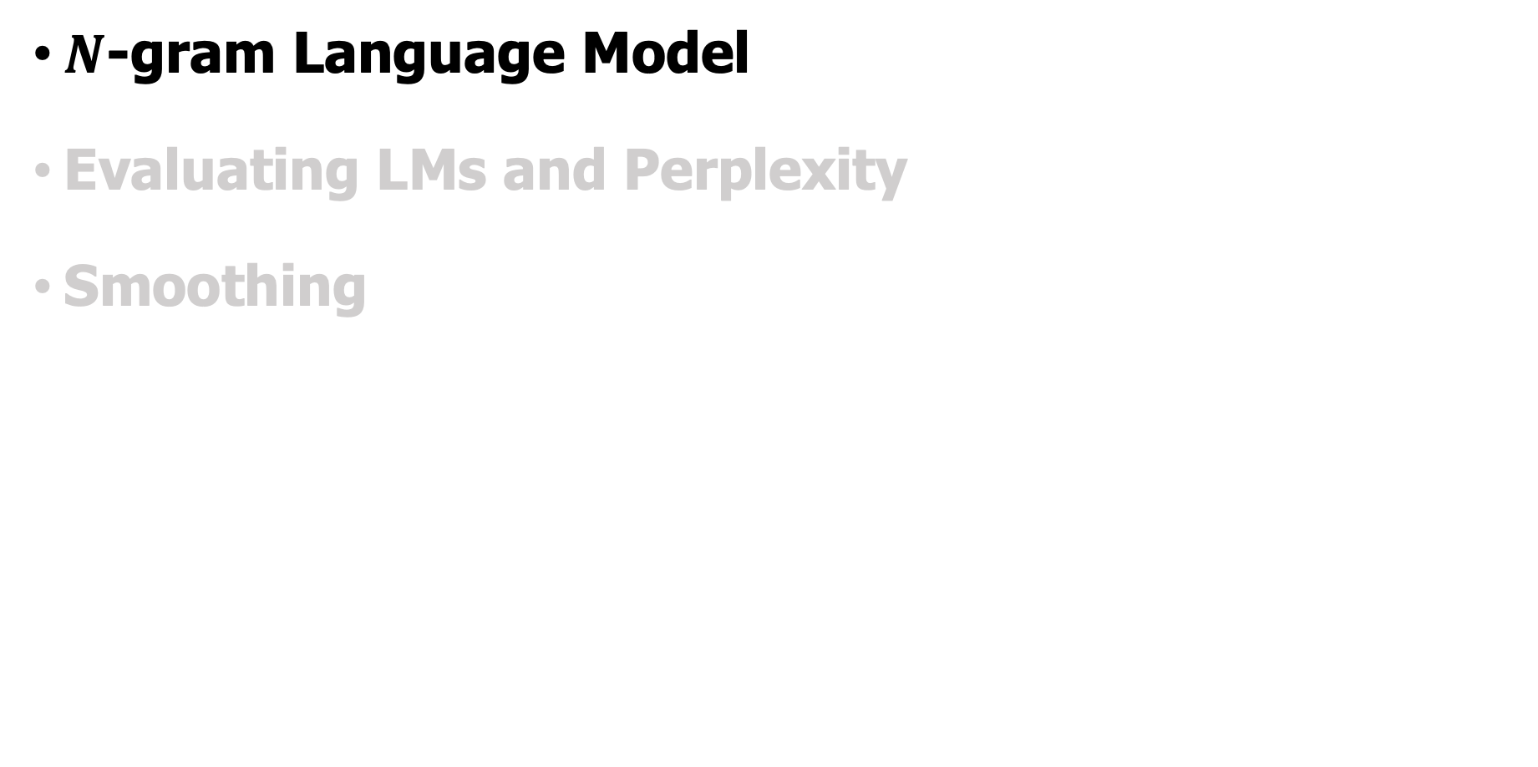
Outline
$N$-gram Language Model
Evaluating LMs and Perplexity
Smoothing
Notes:
-------------------------------------------------------------------------------------

Slide 3
Assign a probability to a sentence
I want to … is often followed by
I want to go to the movies.
I want to learn how to play the guitar.
I want to read more books this year.
I want to improve my cooking skills.
I want to spend more time with my family.
But not
I want to my family.
I want to the time.
I want to guitar.
The probability of these sentences appearing in real-world English corpus is relative large
The probability of these sentences appearing in real-world English corpus is relative small

Slide 4
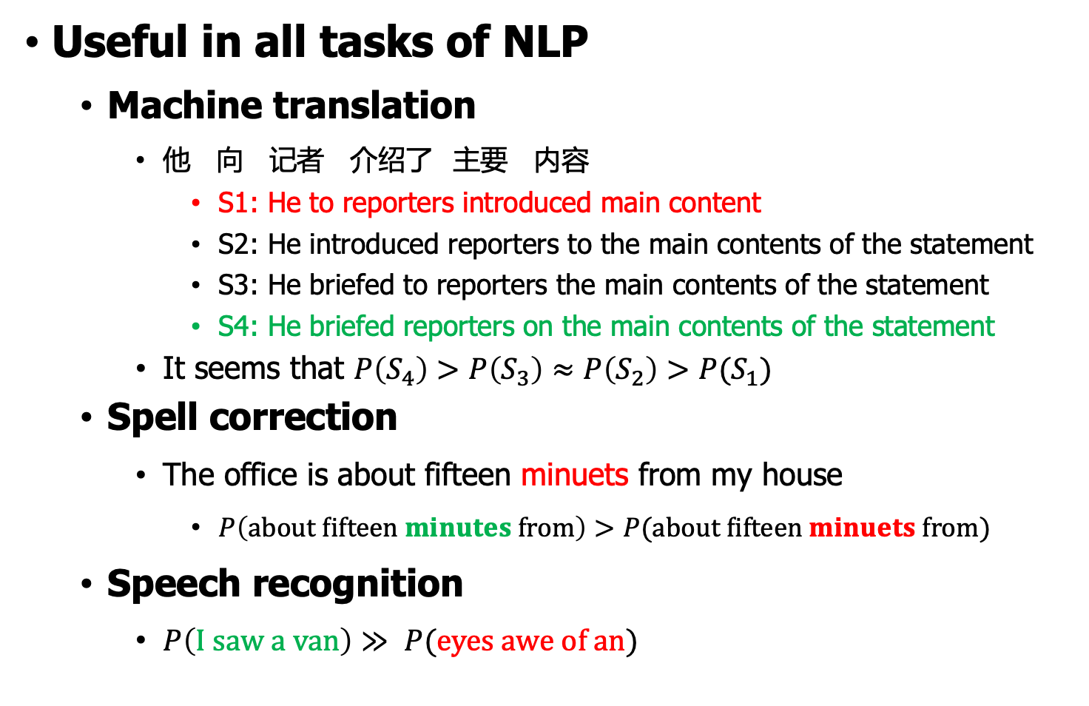
Assign a probability to a sentence
Useful in all tasks of NLP
Machine translation
他 向 记者 介绍了 主要 内容
S1: He to reporters introduced main content
S2: He introduced reporters to the main contents of the statement
S3: He briefed to reporters the main contents of the statement
S4: He briefed reporters on the main contents of the statement
It seems that $P\left(S_{4}\right)>P\left(S_{3}\right)≈P\left(S_{2}\right)>P(S_{1})$
Spell correction
The office is about fifteen minuets from my house
$P\left(about fifteen minutes from\right)>P(about fifteen minuets from)$
Speech recognition
$P\left(I saw a van\right)≫ P(eyes awe of an)$

Slide 5
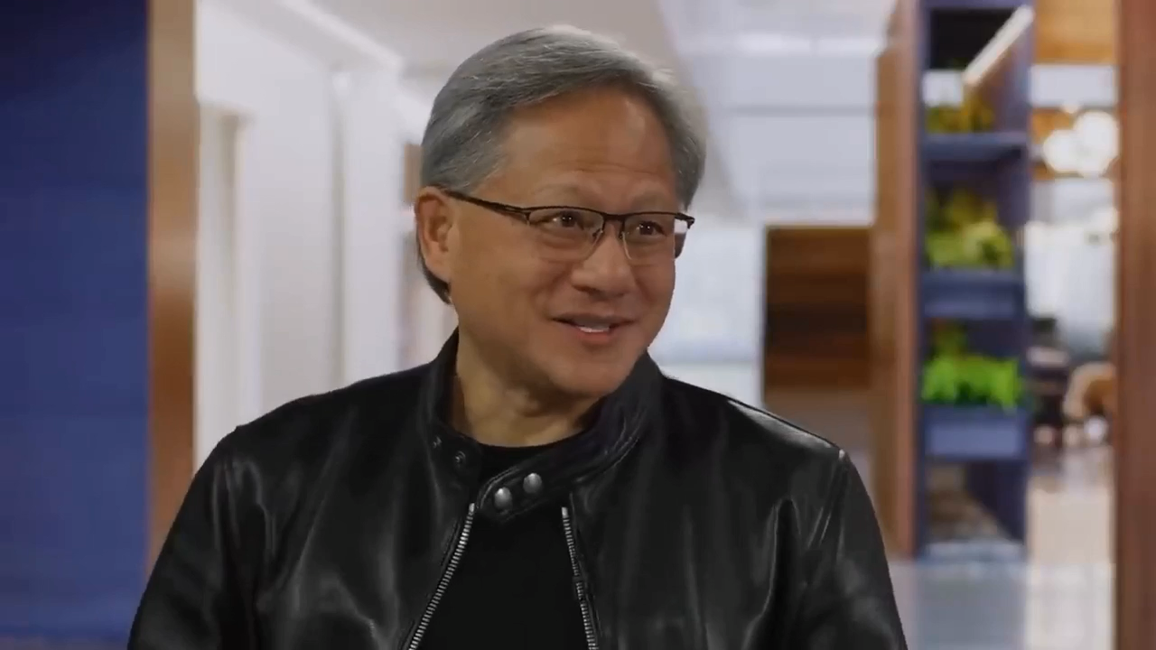
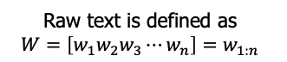
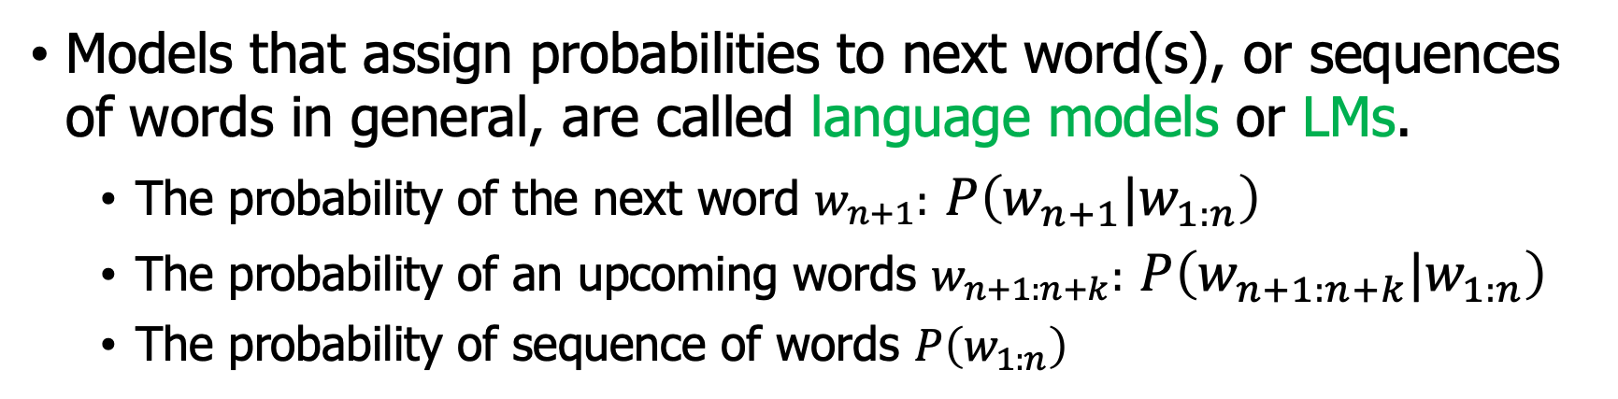
Probabilistic language modeling
Models that assign probabilities to next word(s), or sequences of words in general, are called language models or LMs.
The probability of the next word $w_{n+1}:$ $P\left(w_{n+1}|w_{1:n}\right)$
The probability of an upcoming words $w_{n+1:n+k}:$ $P\left(w_{n+1:n+k}|w_{1:n}\right)$
The probability of sequence of words $P\left(w_{1:n}\right)$
Raw text is defined as
$$W=\left[w_{1}w_{2}w_{3}⋯w_{n}\right]=w_{1:n}$$
Accurately predict next word is super important:
… The base upon which GPT-4 is built predicts the next word with greater accuracy…
… the better a neural network can predict the next word in text, the more it understands it …

Slide 6
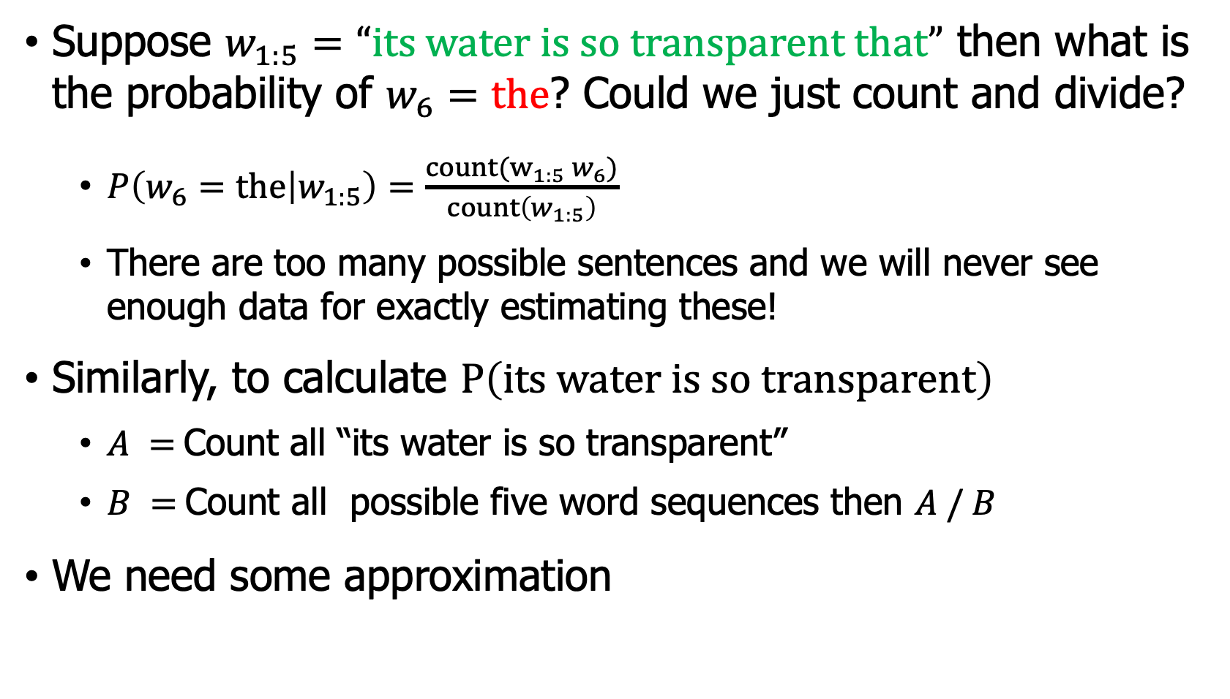
Computing $P\left(w|w_{1:n}\right)$ or $P\left(w_{1:n}\right)$
Suppose $w_{1:5}=“its water is so transparent that”$ then what is the probability of $w_{6}=the$? Could we just count and divide?
$P\left(w_{6}=the | w_{1:5}\right)=\frac{count(w_{1:5} w_{6})}{count\left(w_{1:5}\right)}$
There are too many possible sentences and we will never see enough data for exactly estimating these!
Similarly, to calculate $P\left(its water is so transparent\right)$
$A =$Count all “its water is so transparent”
$B =$Count all possible five word sequences then $A / B$
We need some approximation

Slide 7
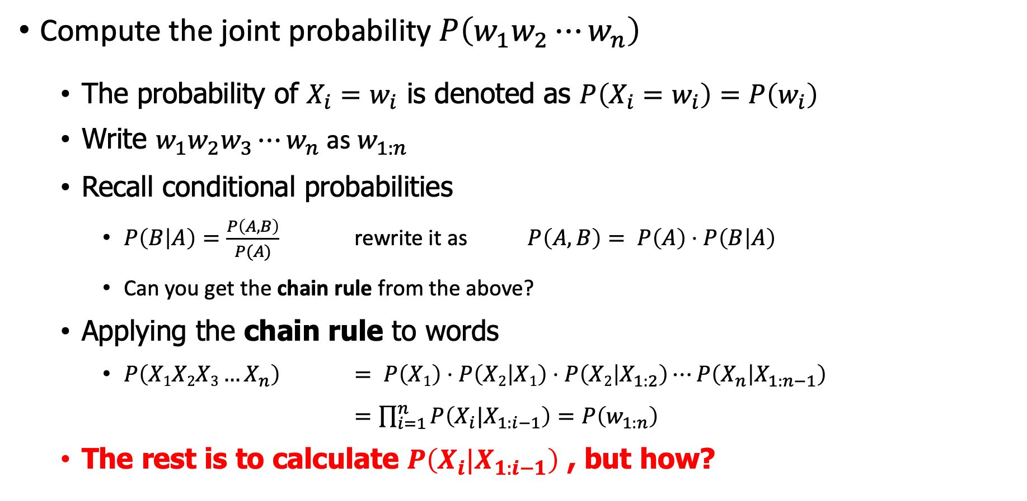
Compute $P(w_{1:n})$
Compute the joint probability $P\left(w_{1}w_{2}⋯w_{n}\right)$
The probability of $X_{i}=w_{i}$ is denoted as $P\left(X_{i}=w_{i}\right)=P\left(w_{i}\right)$
Write $w_{1}w_{2}w_{3}⋯w_{n}$ as $w_{1:n}$
Recall conditional probabilities
$P\left(B | A\right)=\frac{P\left(A,B\right)}{P(A)}$ rewrite it as $P\left(A,B\right)= P\left(A\right)⋅P\left(B | A\right)$
Can you get the chain rule from the above?
Applying the chain rule to words
$P\left(X1X2X3…X_{n}\right)$ $= P\left(X1\right)⋅P\left(X2 | X1\right)⋅P\left(X2 | X_{1:2}\right)⋯P\left(X_{n} | X_{1:n−1}\right)$
$=\prod_{i=1}^{n}{P\left(X_{i}|X_{1:i−1}\right)}=P\left(w_{1:n}\right)$
The rest is to calculate $P\left(X_{i}|X_{1:i−1}\right)$ , but how?
Notes:
-------------------------------------------------------------------------------------

Slide 8
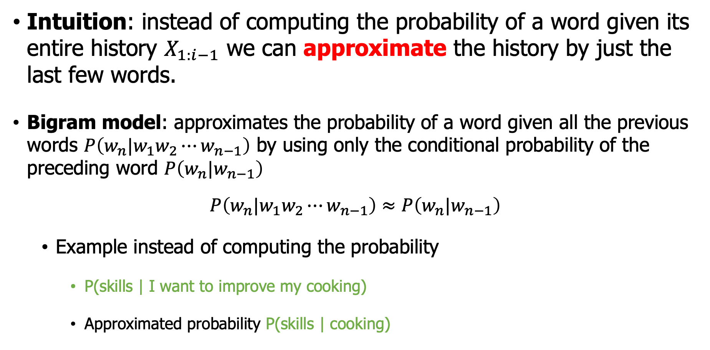
$N$-gram model
Intuition: instead of computing the probability of a word given its entire history $X_{1:i−1}$ we can approximate the history by just the last few words.
Bigram model: approximates the probability of a word given all the previous words $P\left(w_{n}|w_{1}w_{2}⋯w_{n−1}\right)$ by using only the conditional probability of the preceding word $P\left(w_{n}|w_{n−1}\right)$
$$P\left(w_{n}|w_{1}w_{2}⋯w_{n−1}\right)≈P\left(w_{n}|w_{n−1}\right)$$
Example instead of computing the probability
P(skills | I want to improve my cooking)
Approximated probability P(skills | cooking)
Notes:
-------------------------------------------------------------------------------------

Slide 9
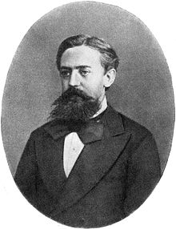
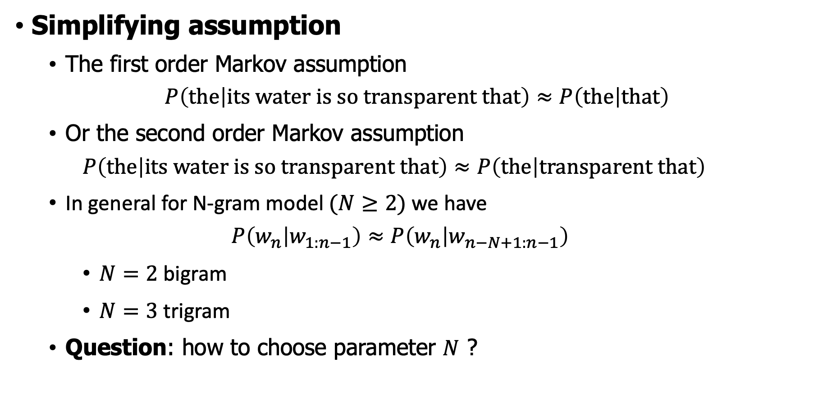
Link to Markov assumption
Simplifying assumption
The first order Markov assumption
$$P\left(the | its water is so transparent that\right)≈P\left(the | that\right)$$
Or the second order Markov assumption
$$P\left(the | its water is so transparent that\right)≈P\left(the | transparent that\right)$$
In general for N-gram model $(N≥2)$ we have
$$P\left(w_{n} | w_{1:n−1}\right)≈P\left(w_{n} | w_{n−N+1:n−1}\right)$$
$N=2$ bigram
$N=3$ trigram
Question: how to choose parameter $N$ ?
Andrey Andreyevich Markov (14 June 1856 – 20 July 1922) was a Russian mathematician best known for his work on stochastic processes. A primary subject of his research later became known as Markov chains or Markov processes.
Notes:
-------------------------------------------------------------------------------------

Slide 10
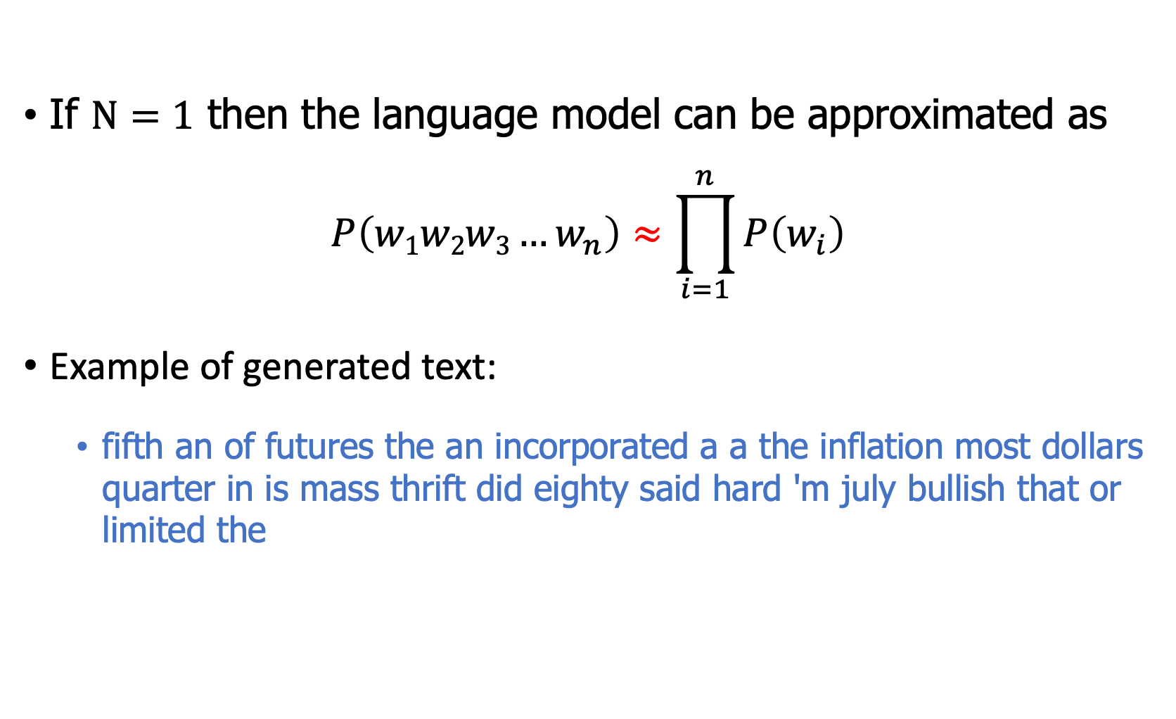
Case $N=1$ : Unigram model
If $N=1$ then the language model can be approximated as
$$P\left(w1w2w3…w_{n}\right)≈\prod_{i=1}^{n}{P\left(w_{i}\right)}$$
Example of generated text:
fifth an of futures the an incorporated a a the inflation most dollars quarter in is mass thrift did eighty said hard 'm july bullish that or limited the

Slide 11
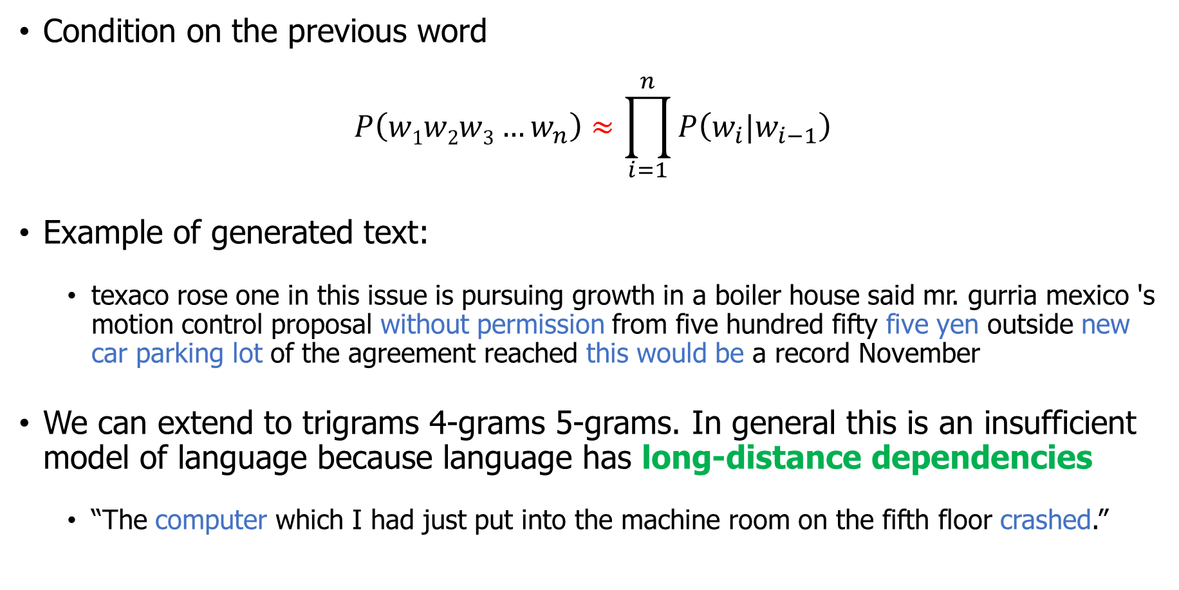
Case $N=2$: bigram model
Condition on the previous word
$$P\left(w1w2w3…w_{n}\right)≈\prod_{i=1}^{n}{P\left(w_{i}|w_{i−1}\right)}$$
Example of generated text:
texaco rose one in this issue is pursuing growth in a boiler house said mr. gurria mexico 's motion control proposal without permission from five hundred fifty five yen outside new car parking lot of the agreement reached this would be a record November
We can extend to trigrams 4-grams 5-grams. In general this is an insufficient model of language because language has long-distance dependencies
“The computer which I had just put into the machine room on the fifth floor crashed.”

Slide 12
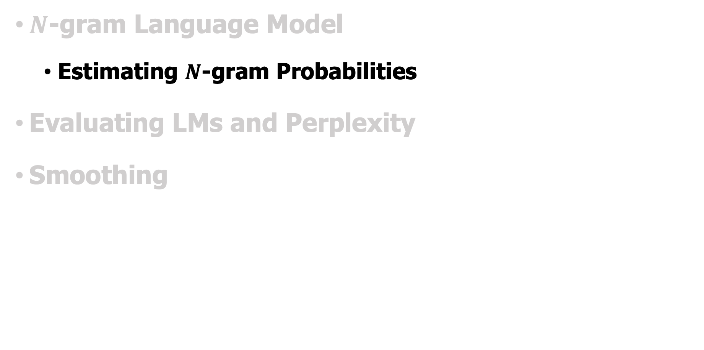
Outline
$N$-gram Language Model
Estimating $N$-gram Probabilities
Evaluating LMs and Perplexity
Smoothing
Notes:
-------------------------------------------------------------------------------------

Slide 13
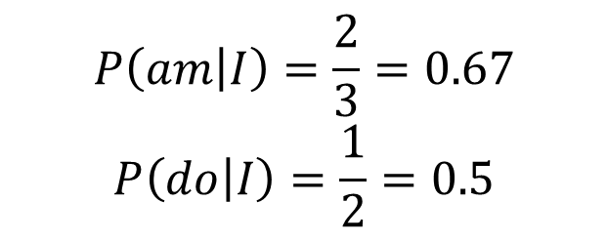
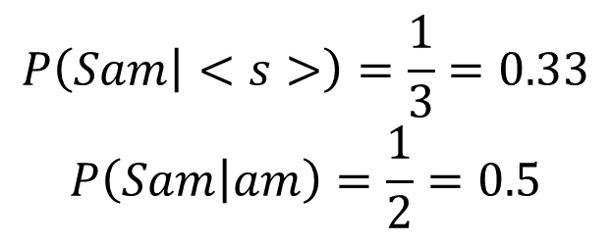
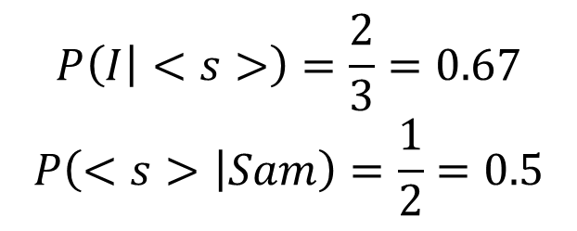
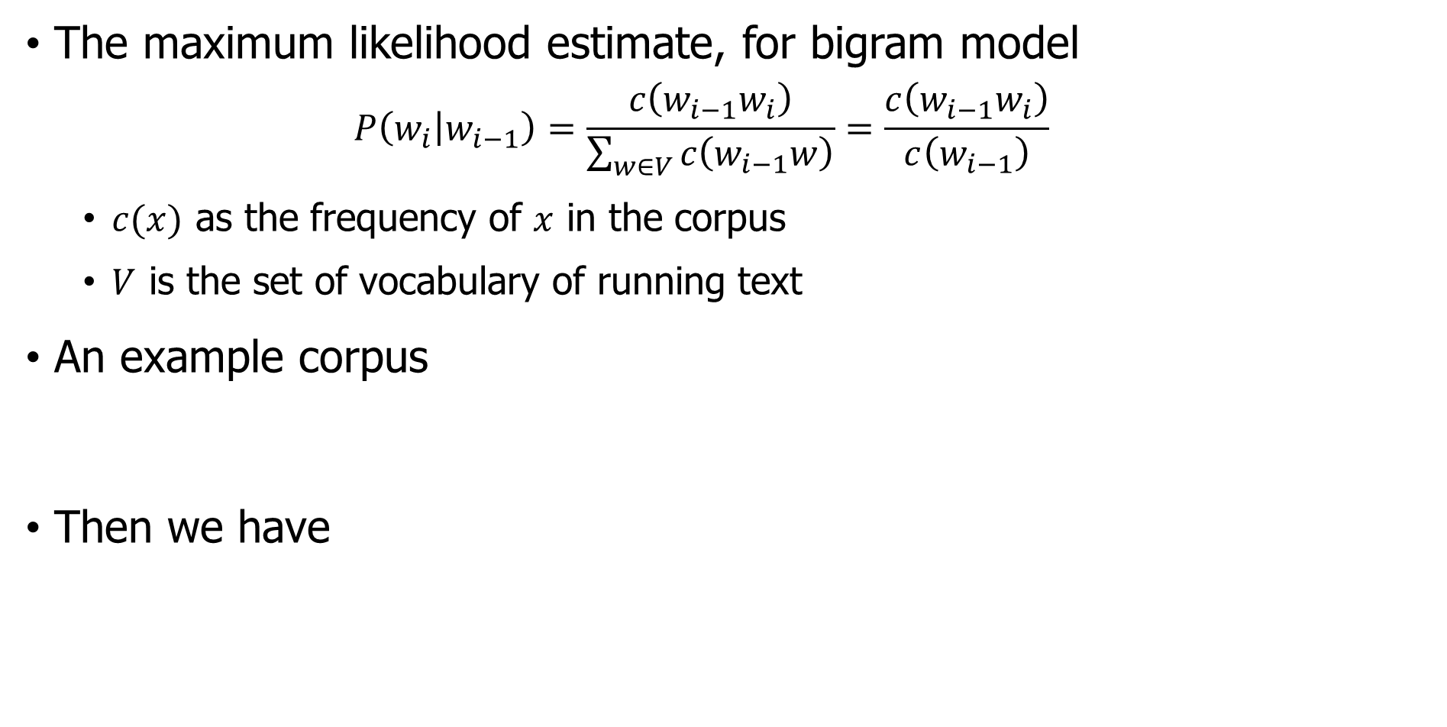
Estimation of $N$-gram probabilities
The maximum likelihood estimate, for bigram model
$$P\left(w_{i} | w_{i−1}\right)=\frac{c\left(w_{i−1}w_{i}\right)}{\sum_{w∈V}{c\left(w_{i−1}w\right)}}=\frac{c\left(w_{i−1}w_{i}\right)}{c\left(w_{i−1}\right)}$$
$c(x)$ as the frequency of $x$ in the corpus
$V$ is the set of vocabulary of running text
An example corpus
Then we have
<s> I am Sam </s>
<s> Sam I am </s>
<s> I do not like eggs and ham </s>
$$P\left(I | <s>\right)=\frac{2}{3}=0.67$$
$$P\left(<s> | Sam\right)=\frac{1}{2}=0.5$$
$$P\left(Sam | <s>\right)=\frac{1}{3}=0.33$$
$$P\left(Sam | am\right)=\frac{1}{2}=0.5$$
$$P\left(am | I\right)=\frac{2}{3}=0.67$$
$$P\left(do | I\right)=\frac{1}{2}=0.5$$
Notes:
-------------------------------------------------------------------------------------

Slide 14
Bigram of a restaurant review corpus
A corpus of resturant reviews (1000 sentences)
Wow... Loved this place.
Not tasty and the texture was just nasty. The selection on the menu was great and so were the prices.
Bigram counts
 | i | want | to | eat | in | this | place
i | 0 | 3 | 0 | 1 | 0 | 0 | 0
want | 0 | 0 | 7 | 0 | 0 | 0 | 0
to | 0 | 0 | 0 | 12 | 1 | 2 | 2
eat | 0 | 0 | 0 | 0 | 2 | 0 | 0
in | 0 | 0 | 3 | 0 | 0 | 2 | 0
this | 0 | 0 | 1 | 0 | 0 | 0 | 73
place | 2 | 0 | 10 | 0 | 2 | 0 | 0
Try the dataset: https://www.kaggle.com/datasets/vigneshwarsofficial/reviews

Slide 15
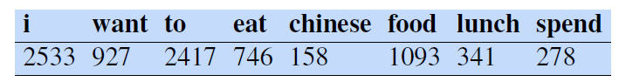
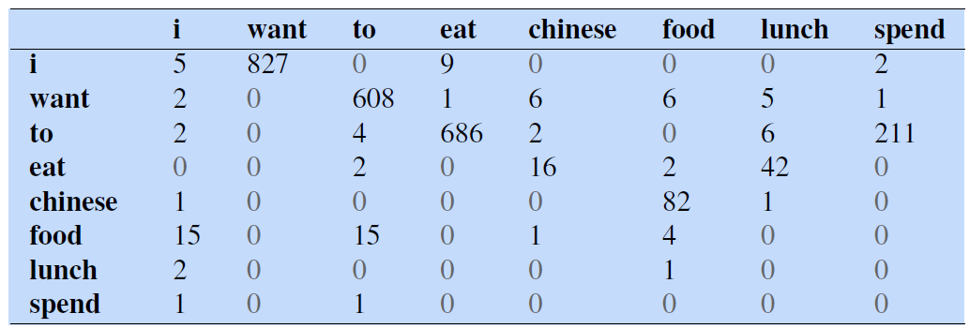
Berkeley restaurant project
A dialogue system that answered questions about a database of restaurants (corpus of 9332 sentences) in Berkeley, California (Jurafsky et al., 1994)
can you tell me about any good cantonese restaurants close by
mid priced thai food is what i’m looking for
Calculate P(<s> i want chinese food </s>) bigram probabilities?

Slide 16
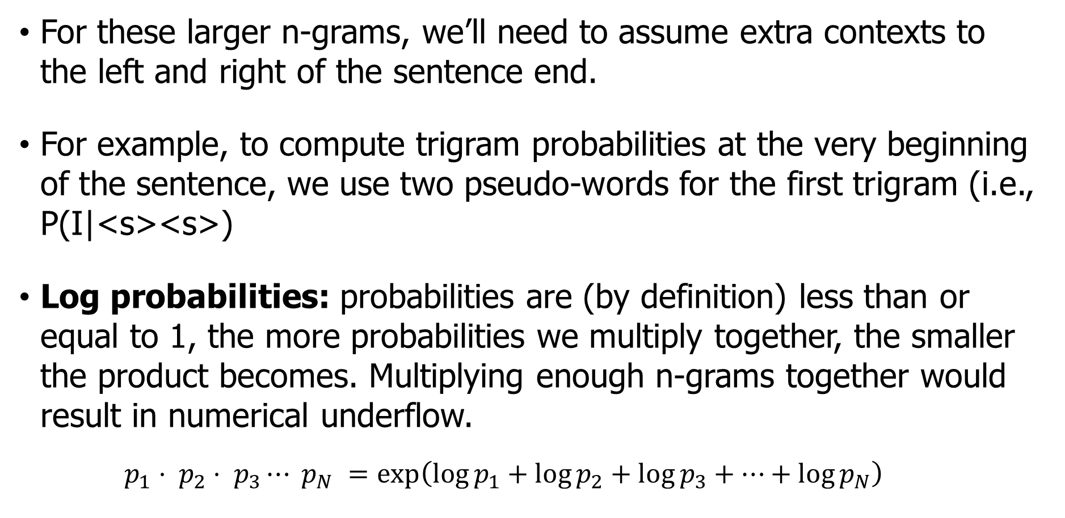
Some practical issues
For these larger n-grams, we’ll need to assume extra contexts to the left and right of the sentence end.
For example, to compute trigram probabilities at the very beginning of the sentence, we use two pseudo-words for the first trigram (i.e., P(I|<s><s>)
Log probabilities: probabilities are (by definition) less than or equal to 1, the more probabilities we multiply together, the smaller the product becomes. Multiplying enough n-grams together would result in numerical underflow.
$$p_{1}⋅ p_{2}⋅ p_{3}⋯ p_{N} =\exp\left(\log{p_{1}}+\log{p_{2}}+\log{p_{3}}+⋯+\log{p_{N}}\right)$$

Slide 17
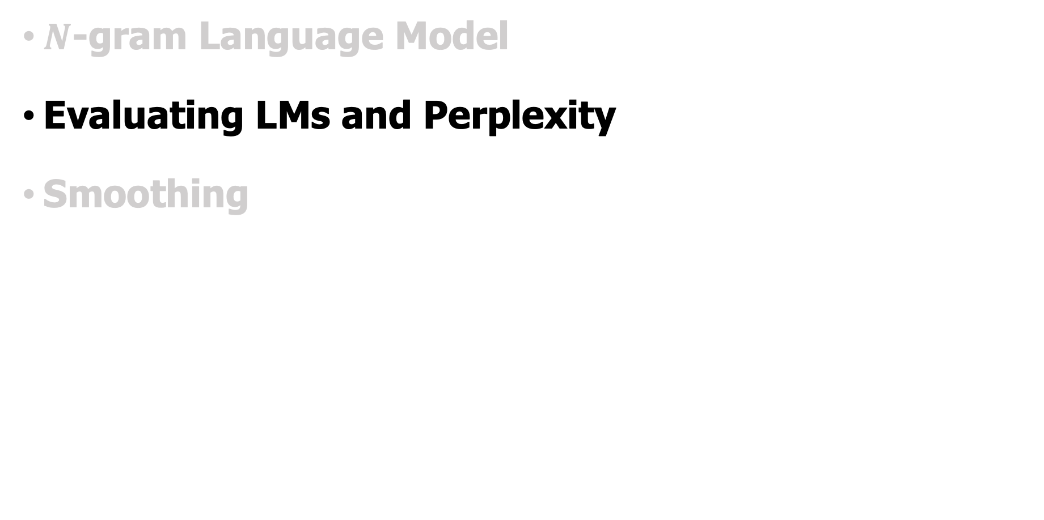
Outline
$N$-gram Language Model
Evaluating LMs and Perplexity
Smoothing
Notes:
-------------------------------------------------------------------------------------

Slide 18
Extrinsic evaluation
Best evaluation for comparing models A and B
Put each model in a task: spelling corrector / MT system
Run the task get an accuracy for A and for B
How many misspelled words corrected properly?
How many words translated correctly?
And then compare accuracy for A and B
Time-consuming (could take days or weeks)

Slide 19
Intrinsic evaluation of LMs
Does our LM prefer good sentences to bad ones?
Assign higher probability to “real” or “frequently observed” sentences than “ungrammatical” or “rarely observed” sentences?
Train parameters of our model on a training set. Test the model’s performance on a test data we have not seen
A test set is an unseen dataset which is totally unused
An evaluation metric tells us how well our model fits the test set
We can’t allow test sentences into the training set
What does it mean to “fit the test set”?
Probability-based metric: Whichever model assigns a higher probability to the test set—meaning it more accurately predicts the test set—is a better model.

Slide 20
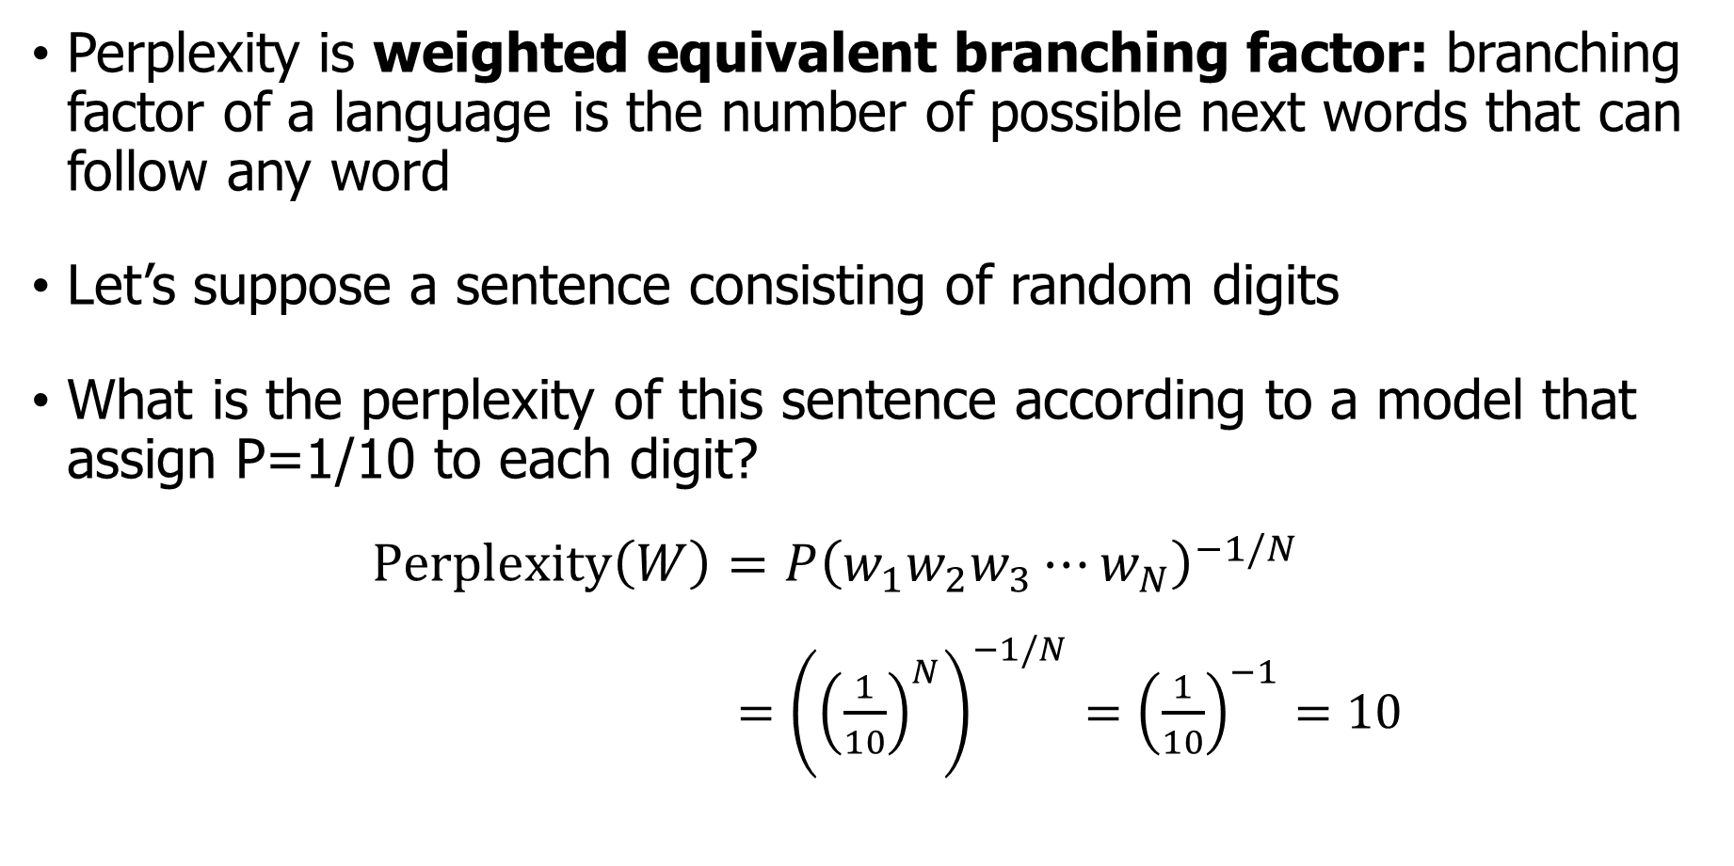
Intuition: Perplexity as branching factor
Perplexity is weighted equivalent branching factor: branching factor of a language is the number of possible next words that can follow any word
Let’s suppose a sentence consisting of random digits
What is the perplexity of this sentence according to a model that assign P=1/10 to each digit?
$$Perplexity\left(W\right)=P{\left(w_{1}w_{2}w_{3}⋯w_{N}\right)}^{−1/N}$$
$={\left({\left(\frac{1}{10}\right)}^{N}\right)}^{−1/N}={\left(\frac{1}{10}\right)}^{−1}=10$

Slide 21
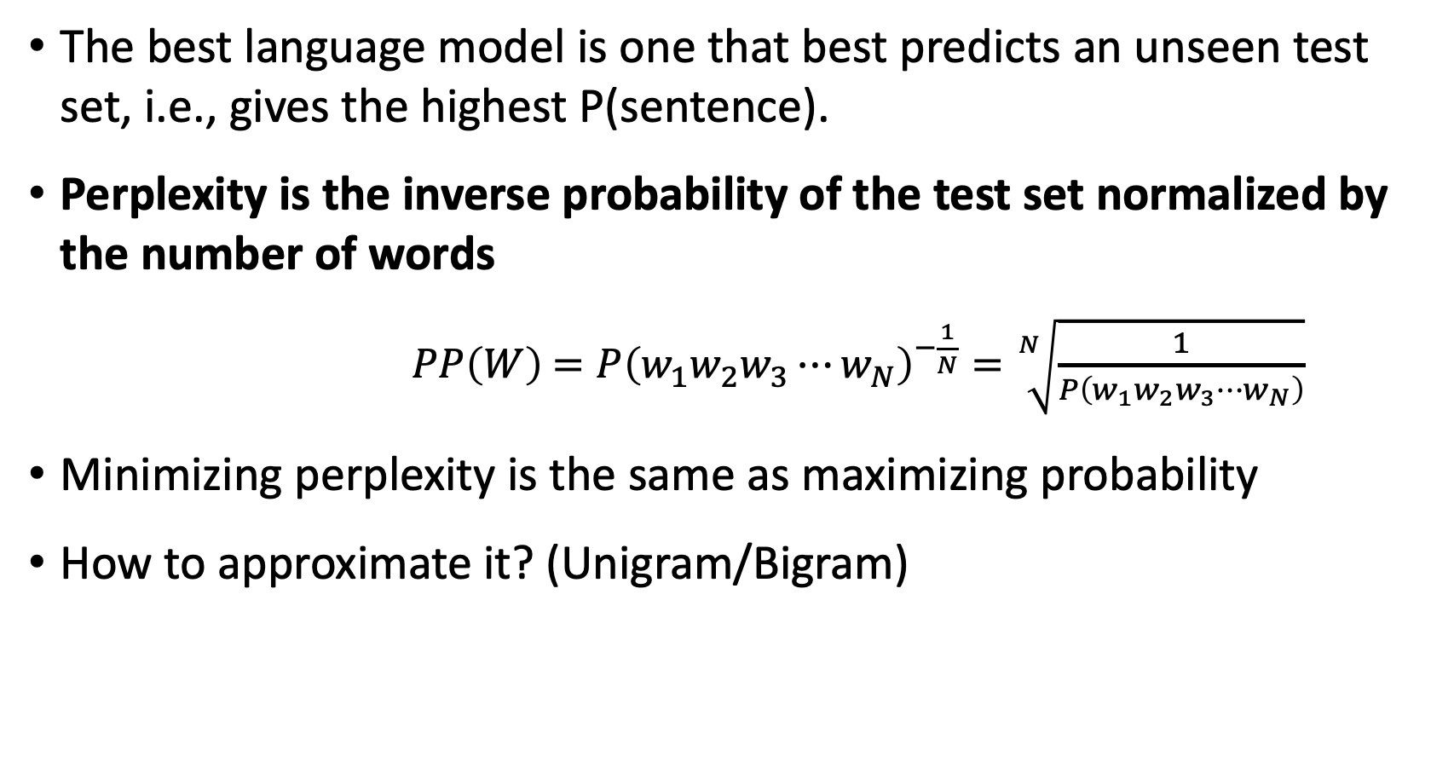
Perplexity
The best language model is one that best predicts an unseen test set, i.e., gives the highest P(sentence).
Perplexity is the inverse probability of the test set normalized by the number of words
$PP\left(W\right)$ $=P{\left(w_{1}w_{2}w_{3}⋯w_{N}\right)}^{−\frac{1}{N}}=\sqrt[N]{\frac{1}{P\left(w_{1}w_{2}w_{3}⋯w_{N}\right)}}$
Minimizing perplexity is the same as maximizing probability
How to approximate it? (Unigram/Bigram)

Slide 22
Lower perplexity – better model
Training 38 million words test 1.5 million words WSJ
The improvement in perplexity does not guarantee an (extrinsic) improvement in the performance of a language processing task like speech recognition or MT
Because perplexity often correlates with such improvements, it is commonly used as a quick check on an algorithm
https://arxiv.org/pdf/2005.14165.pdf (See how GPT-3 uses PPL)
N-gram Order | Unigram | Bigram | Trigram
Perplexity | 962 | 170 | 109

Slide 23
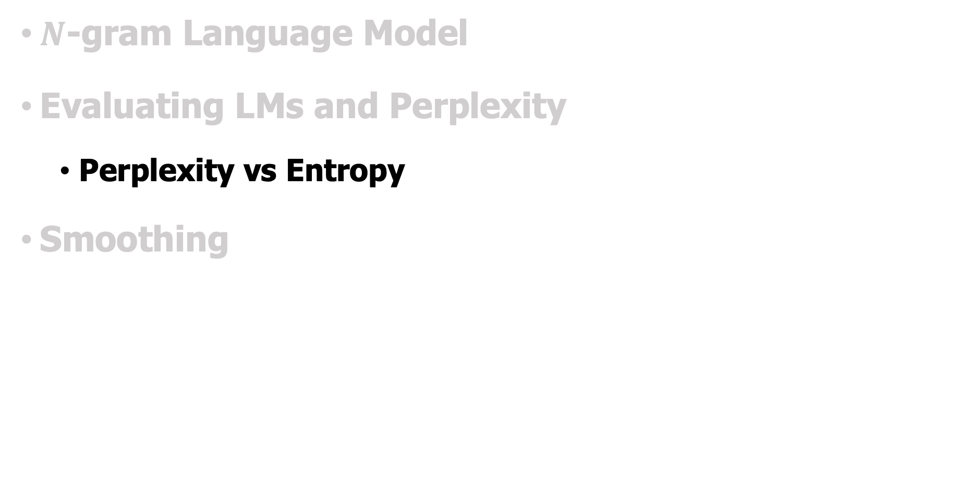
Outline
$N$-gram Language Model
Evaluating LMs and Perplexity
Perplexity vs Entropy
Smoothing
Notes:
-------------------------------------------------------------------------------------

Slide 24
Issues of perplexity
Intuitively, it can be thought of as an evaluation of the model’s ability to predict uniformly among the set of specified tokens in a corpus. Importantly, this means that the tokenization procedure has a direct impact on a model’s perplexity which should always be taken into consideration when comparing different models.

Slide 25
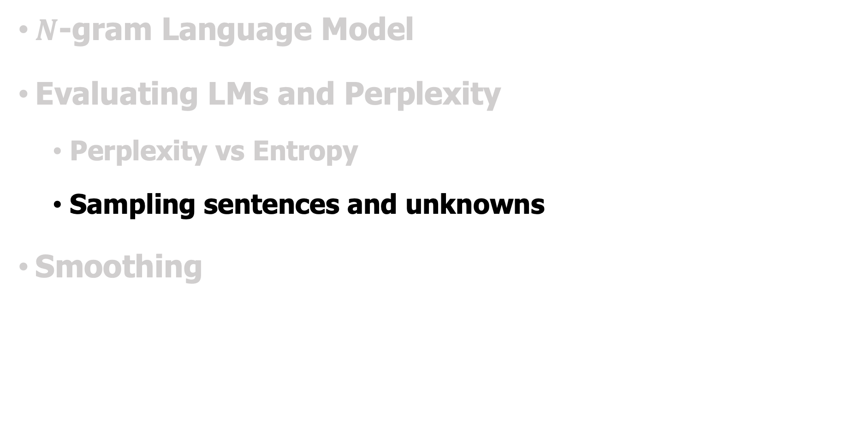
Outline
$N$-gram Language Model
Evaluating LMs and Perplexity
Perplexity vs Entropy
Sampling sentences and unknowns
Smoothing
Notes:
-------------------------------------------------------------------------------------

Slide 26
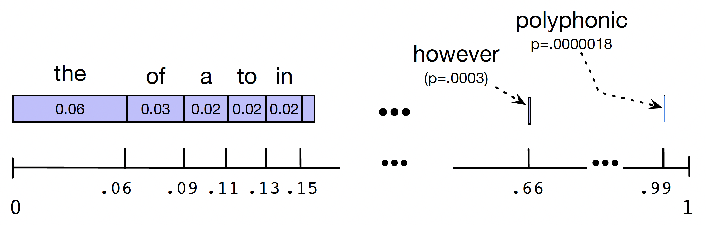
Sentence Sampling
For the unigram case.
Set all the words covering the probability space between 0 and 1, each word covering an interval proportional to its frequency
Choose a random value in [0,1], find that point on the probability line, and print the word whose interval includes this chosen value
Repeat the above step until we see </s>
What about bigram case?

Slide 27
Sampling from built LM
Built LM from Shakespeare’s works (885K tokens)
1-gram: To him swallowed confess hear both. Which. Of save on trail for are ay device and rote life have
2-gram: Why dost stand forth thy canopy, forsooth; he is this palpable hit the King Henry. Live king. Follow.
3-gram: Fly, and will rid me these news of price. Therefore the sadness of parting, as they say, ’tis done
4-gram: King Henry. What! I will go seek the traitor Gloucester. Exeunt some of the watch. A great banquet serv’d in; It cannot be but so.

Slide 28
Sampling from built LM
Built LM from the Wall Street Journal (40M)
1-gram: Months the my and issue of year foreign new exchange’s September were recession exchange new endorsed a acquire to six executives
2-gram: Last December through the way to preserve the Hudson corporation N. B. E. C. Taylor would seem to complete the major central planners one point five percent of U. S. E. has already old M. X. corporation of living on information such as more frequently fishing to keep her
3-gram: They also point to ninety nine point six billion dollars from two hundred four oh six three percent of the rates of interest stores as Mexico and Brazil on market conditions

Slide 29
Unknown Words
The word Baojian simply did not occur in our training set but in our test test
closed vocabulary system: the test set can only contain words from this known lexicon, and there will be no unknown words.
Unknown words, or out of vocabulary (OOV) words
Deal with words we haven’t seen before
Open vocabulary: pseudo-word called <UNK>
How to train the probabilities of the unknown word ?

Slide 30
Unknown Words
Have a prior vocabulary
Choose a vocabulary (word list) that is fixed in advance.
Convert any OOV word in the training set to <UNK>
Estimate the probabilities for <UNK> from its counts
Don’t have a prior vocabulary
Replace words in the training data by <UNK> based on their frequency that occur fewer than n times in the training set, where n is some small number, or equivalently select a vocabulary size V in advance (say 50,000) and choose the top V words by frequency and replace the rest by <UNK>.

Slide 31
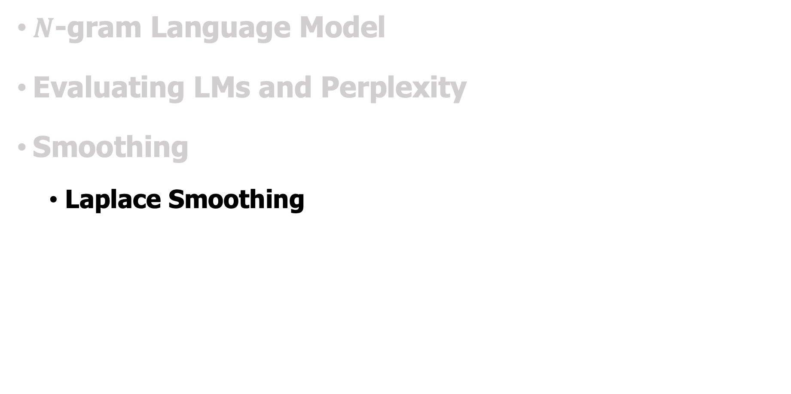
Outline
$N$-gram Language Model
Evaluating LMs and Perplexity
Smoothing
Laplace Smoothing
Notes:
-------------------------------------------------------------------------------------

Slide 32
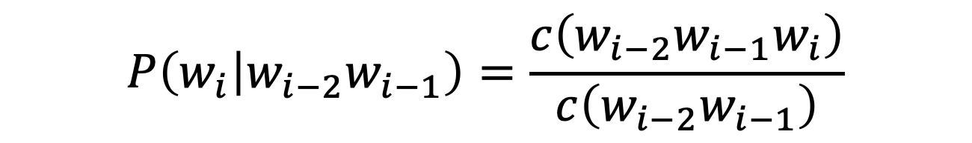
N-gram model estimation: Zeros
The Maximum Likelihood Estimate
Given the following datasets
$$P\left(w_{i} | w_{i−2}w_{i−1}\right)=\frac{c\left(w_{i−2}w_{i−1}w_{i}\right)}{c\left(w_{i−2}w_{i−1}\right)}$$
Training set:
… denied the allegations
… denied the reports
… denied the claims
… denied the request
Test set:
… denied the offer
… denied the loan
P(offer| denied the) ?
Trigrams with zero probability (assign 0 probability)
To compute perplexity how to avoid these zeros?

Slide 33
Smoothing: intuition
When we have sparse statistics
Steal probability mass to generalize better
How to steal?
3 2 1 1 0 0 0 …
P(w | denied the)
allegations
reports
outcome
claims
request
attack
…
man
P(w | denied the)
2.5 allegations
1.5 reports
0.5 claims
0.5 request
2 other
allegations
allegations
attack
man
outcome
reports
…
claims
request

Slide 34
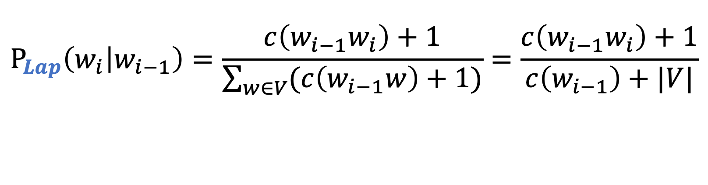
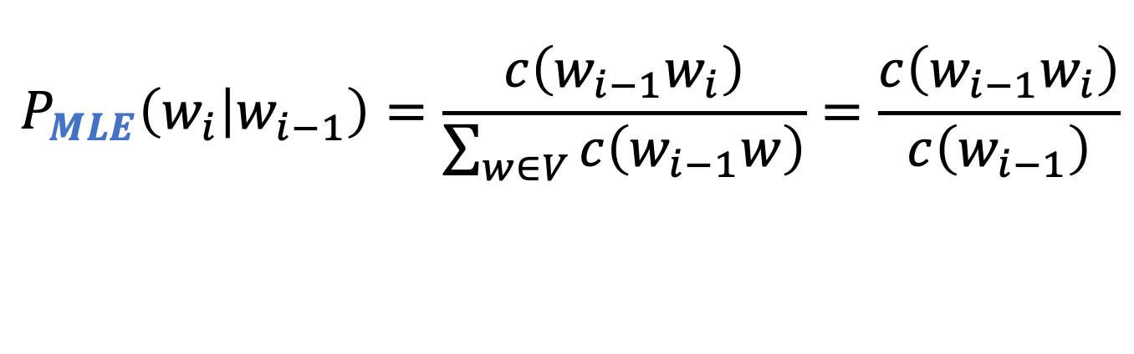
Add-one estimation (Laplace smoothing)
MLE estimate
Add-one estimate
pretend we saw each word one more time than we did
$$P_{MLE}\left(w_{i} | w_{i−1}\right)=\frac{c\left(w_{i−1}w_{i}\right)}{\sum_{w∈V}{c\left(w_{i−1}w\right)}}=\frac{c\left(w_{i−1}w_{i}\right)}{c\left(w_{i−1}\right)}$$
$$P_{Lap}\left(w_{i} | w_{i−1}\right)=\frac{c\left(w_{i−1}w_{i}\right)+1}{\sum_{w∈V}{(c\left(w_{i−1}w\right)+1)}}=\frac{c\left(w_{i−1}w_{i}\right)+1}{c\left(w_{i−1}\right)+|V|}$$

Slide 35
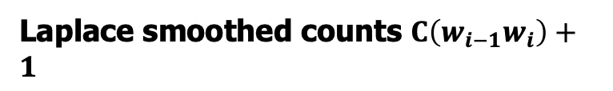
Raw bigram counts $C\left(w_{i−1}w_{i}\right)$
Training dataset (9222 sentences of restaurant reviews)
Add-one smoothing (Adding 1 to all bigram counts)
 | i | want | to | eat | chinese | food | lunch | spend
i | 5 | 827 | 0 | 9 | 0 | 0 | 0 | 2
want | 2 | 0 | 608 | 1 | 6 | 6 | 5 | 1
to | 2 | 0 | 4 | 686 | 2 | 0 | 6 | 211
eat | 0 | 0 | 2 | 0 | 16 | 2 | 42 | 0
chinese | 1 | 0 | 0 | 0 | 0 | 82 | 1 | 0
food | 15 | 0 | 15 | 0 | 1 | 4 | 0 | 0
lunch | 2 | 0 | 0 | 0 | 0 | 1 | 0 | 0
spend | 1 | 0 | 1 | 0 | 0 | 0 | 0 | 0
 | i | want | to | eat | chinese | food | lunch | spend
i | 6 | 828 | 1 | 10 | 1 | 1 | 1 | 3
want | 3 | 1 | 609 | 2 | 7 | 7 | 6 | 2
to | 3 | 1 | 5 | 687 | 3 | 1 | 7 | 212
eat | 1 | 1 | 3 | 1 | 17 | 3 | 43 | 1
chinese | 2 | 1 | 1 | 1 | 1 | 83 | 2 | 1
food | 16 | 1 | 16 | 1 | 2 | 5 | 1 | 1
lunch | 3 | 1 | 1 | 1 | 1 | 2 | 1 | 1
spend | 2 | 1 | 2 | 1 | 1 | 1 | 1 | 1
Laplace smoothed counts $C\left(w_{i−1}w_{i}\right)+1$

Slide 36

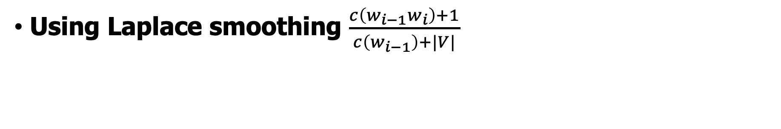
Laplace-smoothed bigrams
Using Laplace smoothing $\frac{c\left(w_{i−1}w_{i}\right)+1}{c\left(w_{i−1}\right)+|V|}$
 | i | want | to | eat | chinese | food | lunch | spend
i | 0.0015 | 0.21 | 0.00025 | 0.0025 | 0.00025 | 0.00025 | 0.00025 | 0.00075
want | 0.0013 | 0.00042 | 0.26 | 0.00084 | 0.0029 | 0.0029 | 0.0025 | 0.00084
to | 0.00078 | 0.00026 | 0.0013 | 0.18 | 0.00078 | 0.00026 | 0.0018 | 0.055
eat | 0.00046 | 0.00046 | 0.0014 | 0.00046 | 0.0078 | 0.0014 | 0.02 | 0.00046
chinese | 0.0012 | 0.00062 | 0.00062 | 0.00062 | 0.00062 | 0.052 | 0.0012 | 0.00062
food | 0.0063 | 0.00039 | 0.0063 | 0.00039 | 0.00079 | 0.002 | 0.00039 | 0.00039
lunch | 0.0017 | 0.00056 | 0.00056 | 0.00056 | 0.00056 | 0.0011 | 0.00056 | 0.00056
spend | 0.0012 | 0.00058 | 0.0012 | 0.00058 | 0.00058 | 0.00058 | 0.00058 | 0.00058
How much have $C\left(w_{i−1}w_{i}\right)$ changed?

Slide 37
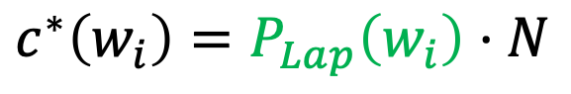
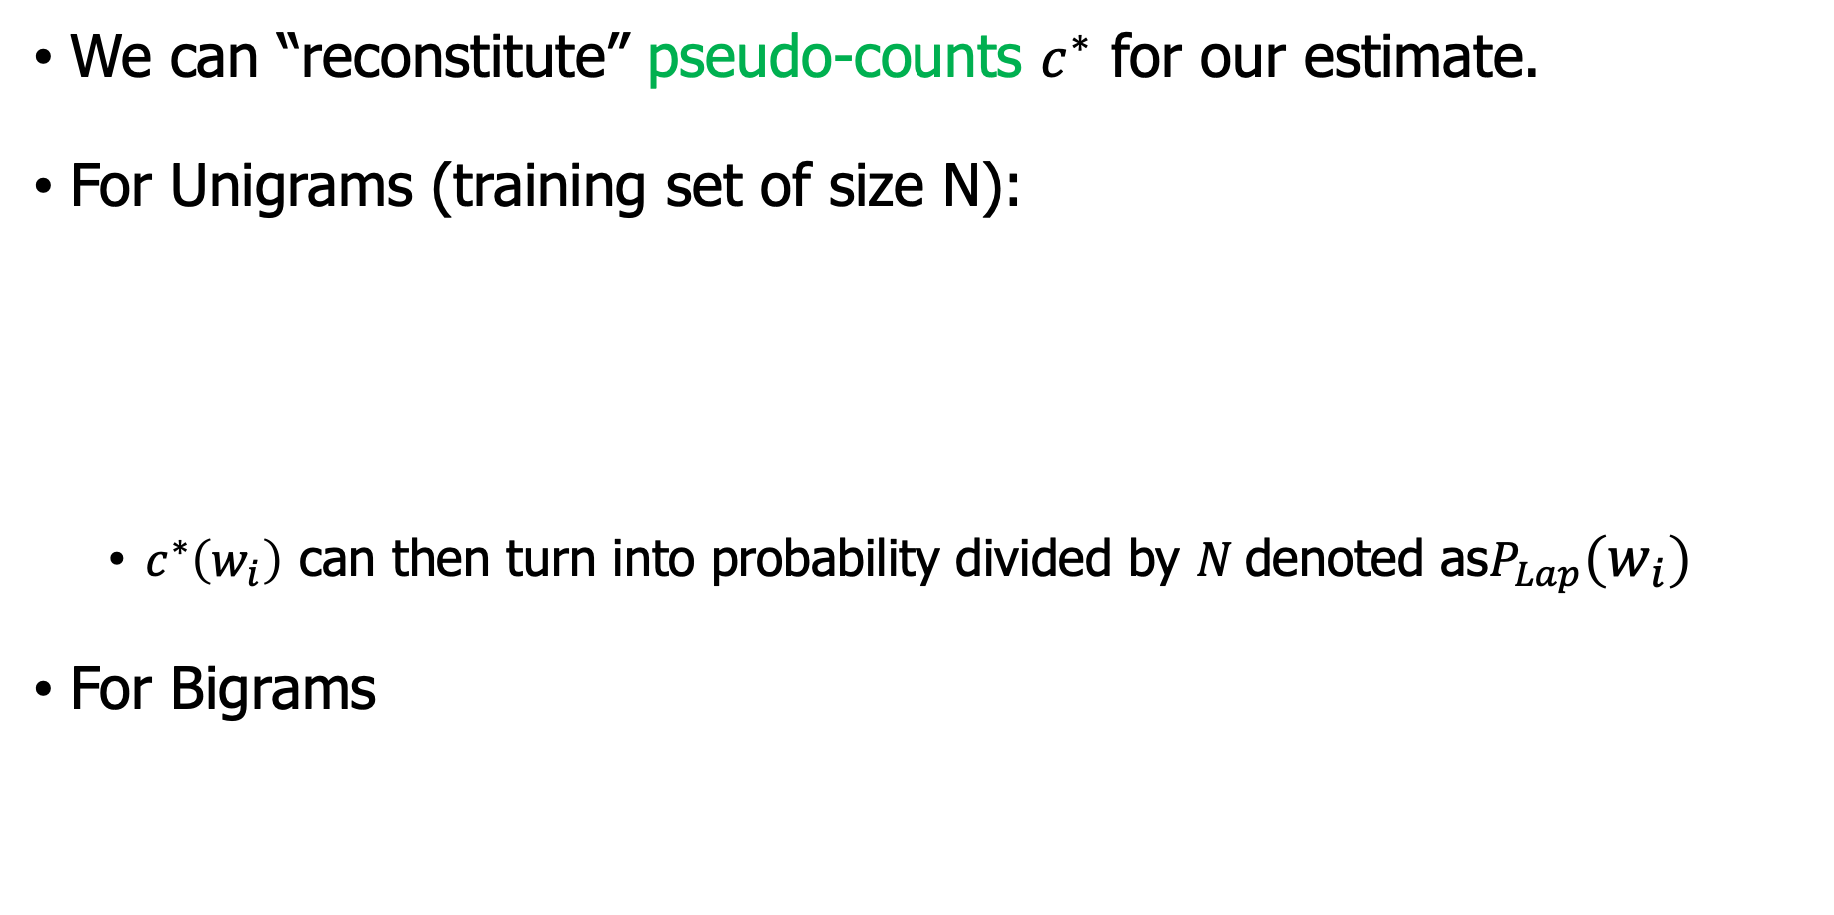
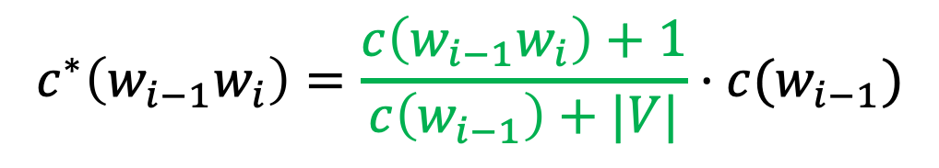
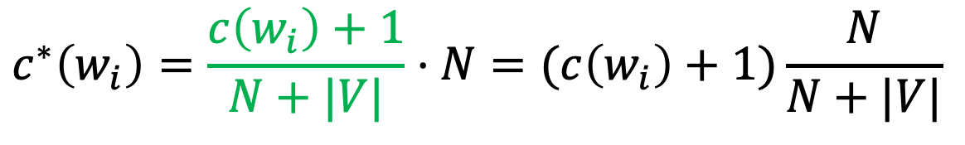
Reconstituted counts
We can “reconstitute” pseudo-counts $c^{∗}$ for our estimate.
For Unigrams (training set of size N):
$c^{∗}\left(w_{i}\right)$ can then turn into probability divided by $N$denoted as$P_{Lap}\left(w_{i}\right)$
For Bigrams
$$c^{∗}\left(w_{i}\right)=P_{Lap}\left(w_{i}\right)⋅N$$
$$c^{∗}\left(w_{i}\right)=\frac{c\left(w_{i}\right)+1}{N+|V|}⋅N=(c\left(w_{i}\right)+1)\frac{N}{N+|V|}$$
$$c^{∗}\left(w_{i−1}w_{i}\right)=P_{Lap}\left(w_{i} | w_{i−1}\right)⋅c(w_{i−1})$$
$$c^{∗}\left(w_{i−1}w_{i}\right)=\frac{c\left(w_{i−1}w_{i}\right)+1}{c\left(w_{i−1}\right)+|V|}⋅c(w_{i−1})$$

Slide 38
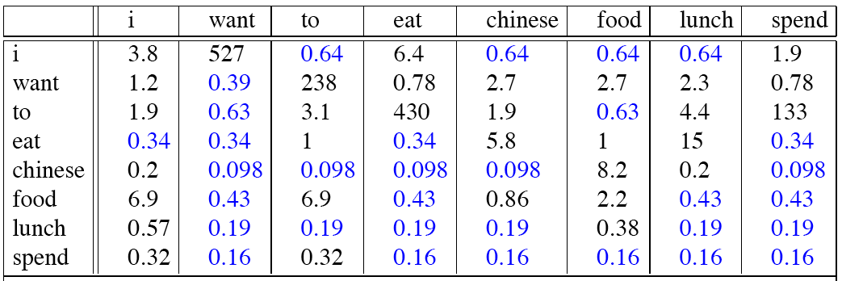
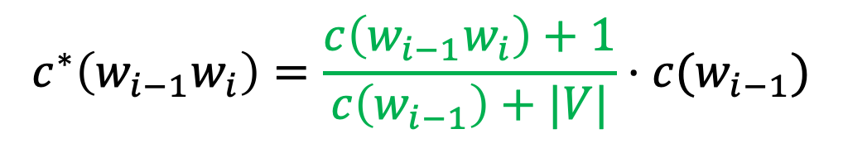
Reconstituted counts for bigram model
Recall the reconstituted counts
$$c^{∗}\left(w_{i−1}w_{i}\right)=\frac{c\left(w_{i−1}w_{i}\right)+1}{c\left(w_{i−1}\right)+|V|}⋅c(w_{i−1})$$

Slide 39
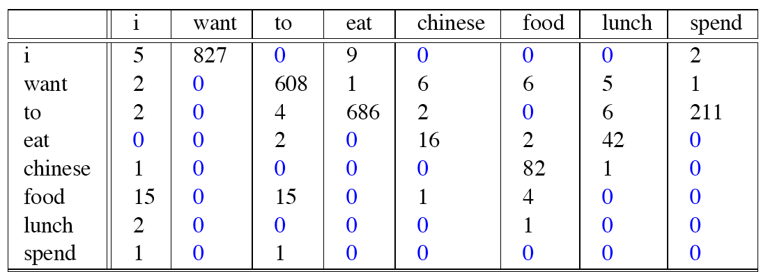
Reconstituted counts
Before Add-one Smoothing
After Add-one Smoothing
Some counts changed too much!

Slide 40
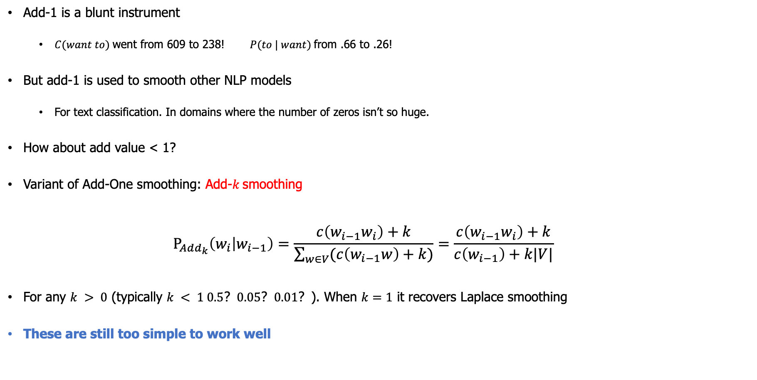
Add-1 smoothing – Quick Summary
Add-1 is a blunt instrument
$C(want to)$went from 609 to 238! $P(to | want)$from .66 to .26!
But add-1 is used to smooth other NLP models
For text classification. In domains where the number of zeros isn’t so huge.
How about add value < 1?
Variant of Add-One smoothing: Add-$k$smoothing
$$P_{Add_{k}}\left(w_{i} | w_{i−1}\right)=\frac{c\left(w_{i−1}w_{i}\right)+k}{\sum_{w∈V}{(c\left(w_{i−1}w\right)+k)}}=\frac{c\left(w_{i−1}w_{i}\right)+k}{c\left(w_{i−1}\right)+k|V|}$$
For any $k > 0$ (typically $k < 1 0.5？0.05？0.01？$). When $k=1$ it recovers Laplace smoothing
These are still too simple to work well

Slide 41
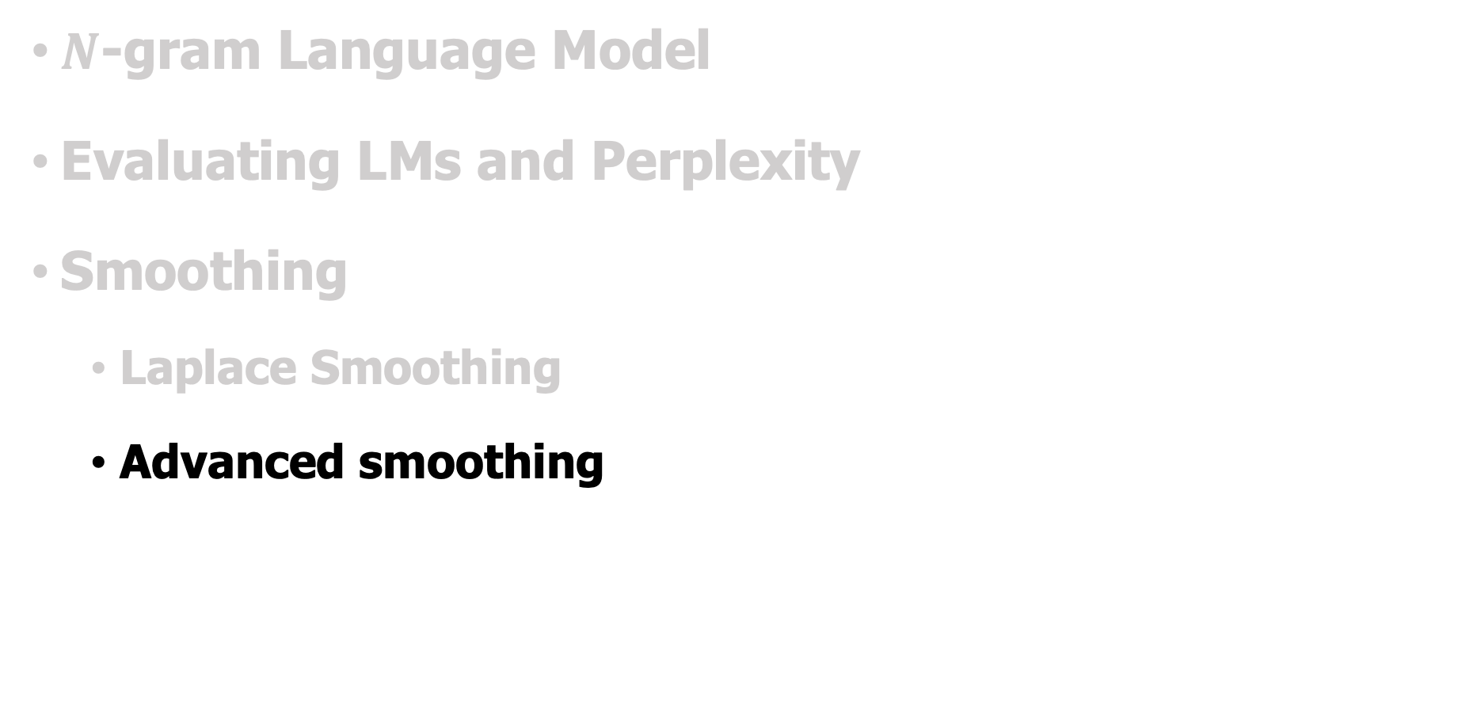
Outline
$N$-gram Language Model
Evaluating LMs and Perplexity
Smoothing
Laplace Smoothing
Advanced smoothing
Notes:
-------------------------------------------------------------------------------------

Slide 42
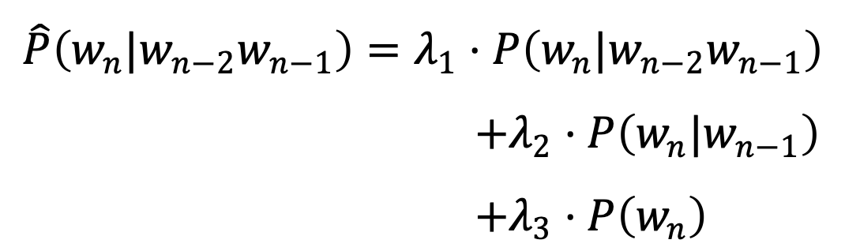
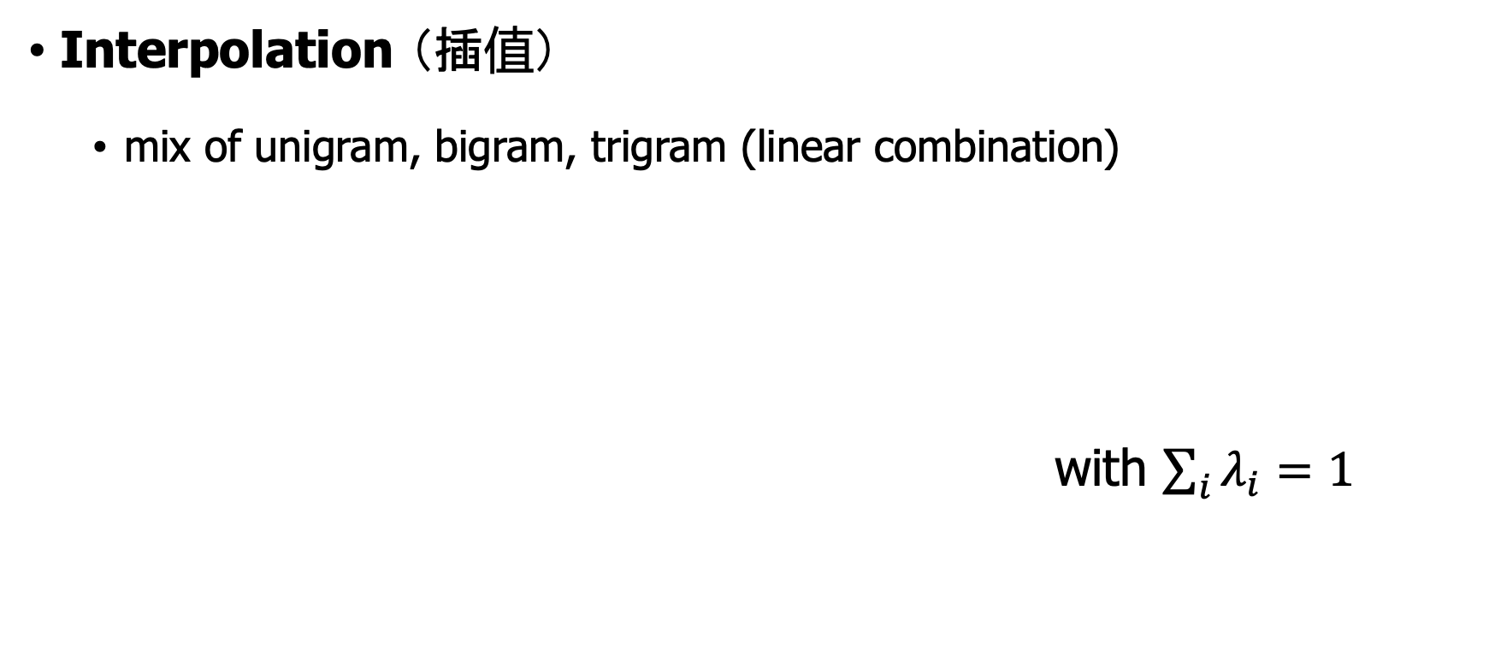

1. Interpolation Smoothing
Interpolation （插值）
mix of unigram, bigram, trigram (linear combination)
with $\sum_{i}{λ_{i}=1}$
$$\hat{P}\left(w_{n}|w_{n−2}w_{n−1}\right)=λ_{1}⋅P\left(w_{n}|w_{n−2}w_{n−1}\right)$$
$+λ_{2}⋅P\left(w_{n}|w_{n−1}\right)$
$+λ_{3}⋅P\left(w_{n}\right)$
How to set these $λ_{i}$?

Slide 43
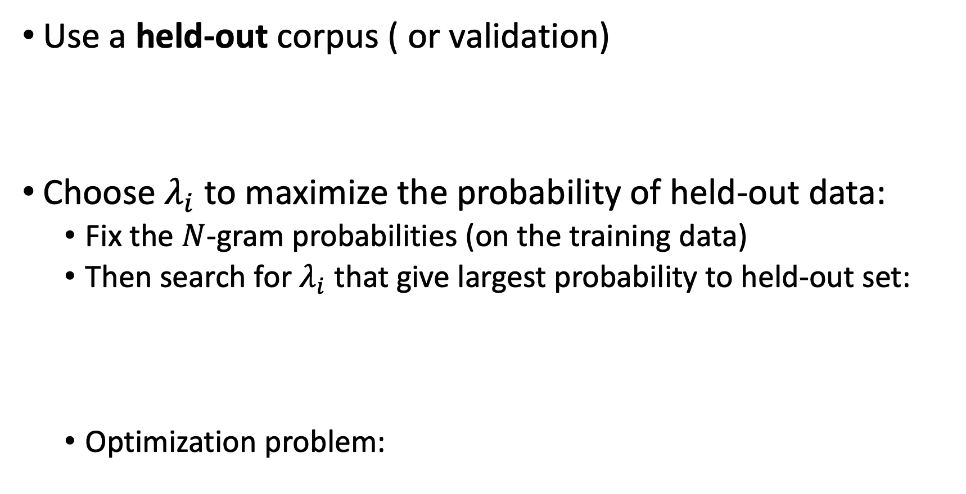
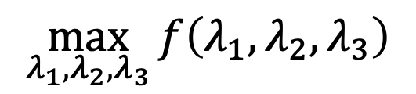
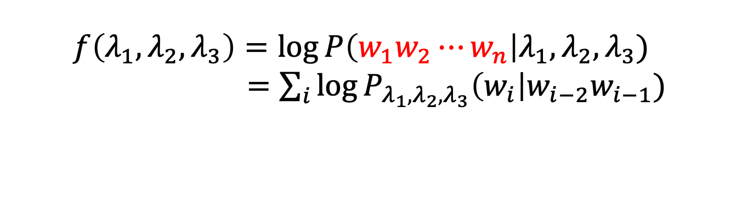
1. Interpolation Smoothing
Use a held-out corpus ( or validation)
Choose $λ_{i}$ to maximize the probability of held-out data:
Fix the $N$-gram probabilities (on the training data)
Then search for $λ_{i}$ that give largest probability to held-out set:
Optimization problem:
Training Data
Held-Out Data
Test
Data
$$f\left(λ_{1},λ_{2},λ_{3}\right)=\log{P\left(w_{1}w_{2}⋯w_{n}\right|λ_{1},λ_{2},λ_{3}) }$$
$=\sum_{i}{\log{P_{λ_{1},λ_{2},λ_{3}}\left(w_{i}\right|w_{i−2}w_{i−1})}}$
$$\max_{λ_{1},λ_{2},λ_{3}}{f\left(λ_{1},λ_{2},λ_{3}\right)}$$

Slide 44
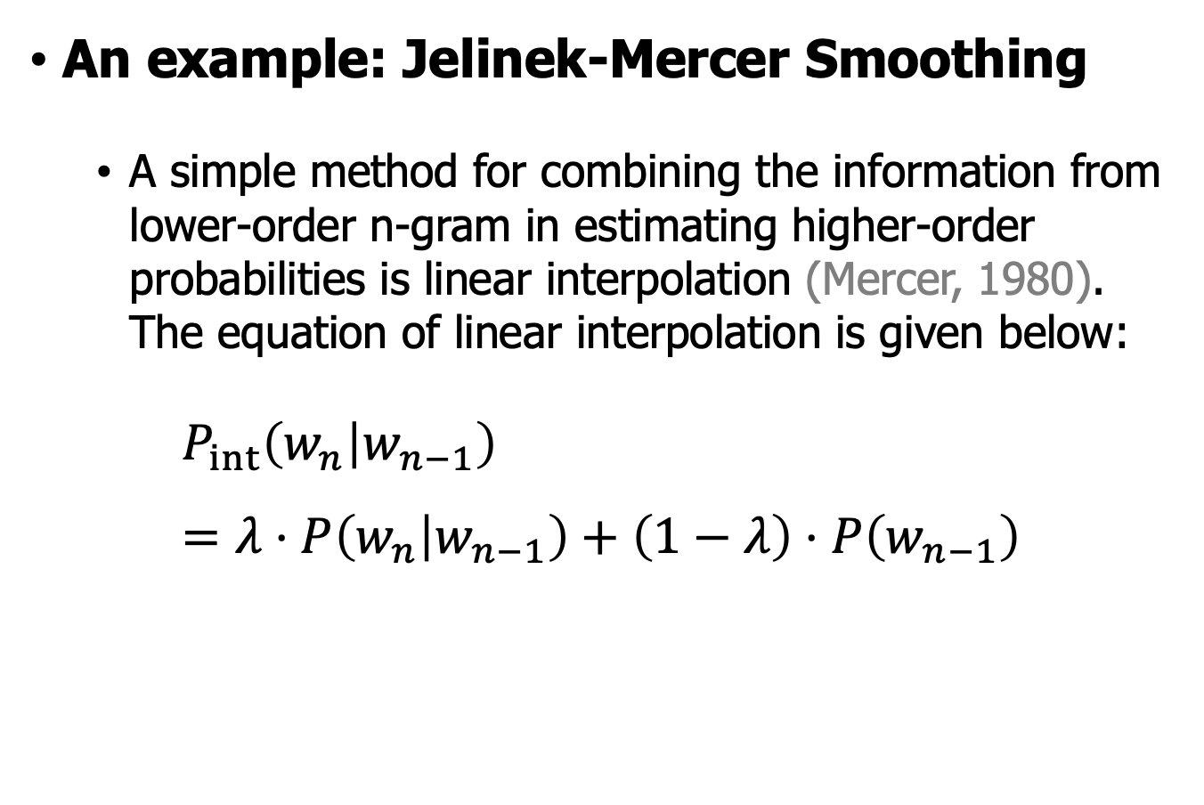
1. Interpolation Smoothing
An example: Jelinek-Mercer Smoothing
A simple method for combining the information from lower-order n-gram in estimating higher-order probabilities is linear interpolation (Mercer, 1980). The equation of linear interpolation is given below:
$$P_{int}\left(w_{n} | w_{n−1}\right)=λ⋅P\left(w_{n} | w_{n−1}\right)+\left(1−λ\right)⋅P\left(w_{n−1}\right)$$

Slide 45
2. Good-Turing Frequency Estimation
Consider the following toy problem
You are picking balls from a box, which has many different colored balls. You have picked
10 red balls
3 blue balls
2 white balls
1 yellow ball
1 black ball
1 green ball
How likely is it that next ball picked is pink?

Slide 46
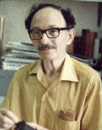
2. Good-Turing Frequency Estimation
Good–Turing frequency estimation is a statistical technique for estimating the probability of encountering an object of a hitherto unseen species, given a set of past observations of objects from different species.
Good-Turing frequency estimation was developed by Alan Turing and his assistant I. J. Good as part of their methods used at Bletchley Park for cracking German ciphers for the Enigma machine during World War II.
Irving John Good
(9 Dec. 1916 – 5 April 2009)

Slide 47
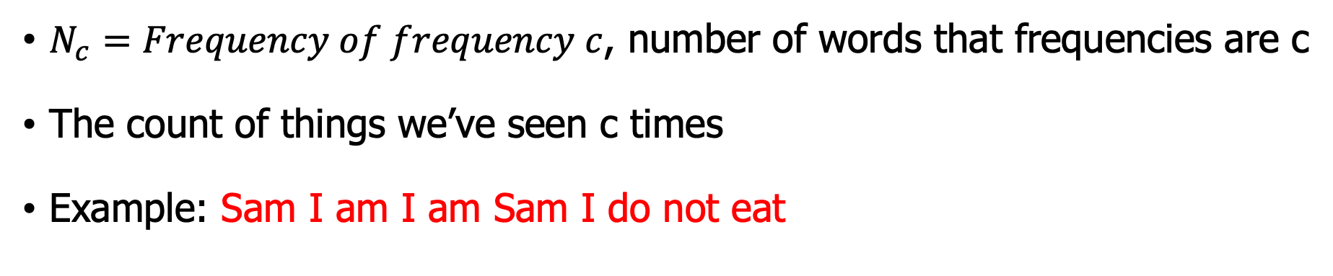
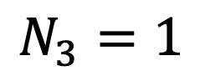


2. Good-Turing Frequency of frequency
$N_{c}=Frequency of frequency c$, number of words that frequencies are c
The count of things we’ve seen c times
Example: Sam I am I am Sam I do not eat
Unigram | Count
I | 3
Sam | 2
am | 2
do | 1
not | 1
eat | 1
$$N_{1}=3$$
$$N_{2}=2$$
$$N_{3}=1$$

Slide 48

2. Good-Turing smoothing: intuition
Use the count of things we have seen once to estimate the count of things we have never seen.
You are fishing and caught
10 carp 3 perch 2 whitefish 1 trout 1 salmon 1 eel = 18 fish
How likely is it that next species is salmon? Maybe $1/18$
How likely is it that next species is new (i.e. catfish or bass)?
Use our estimate of things-we-saw-once to estimate the new things
$3/18 （N_{1}=3）$
Assuming so how likely is it that next species is salmon?
Must be less than 1/18
How to estimate?

Slide 49





2. Good-Turing smoothing: calculations
$$P_{GT}(things with zero frequency)=\frac{N_{1}}{N}$$
$c^{∗}=\frac{(c+1)N_{c+1}}{N_{c}}$, $P_{GT}^{∗}\left(w_{i,c}\right)=\frac{c^{∗}}{N}$
Unseen (bass or catfish)
c = 0:
MLE: p = 0/18 = 0
Seen once (salmon)
c = 1
MLE: p = 1/18
$$P_{GT}^{∗}\left(unseen\right)=\frac{N_{1}}{N}=\frac{3}{18}$$
$$P_{GT}^{∗}\left(salmon\right)=\frac{\left(\frac{2}{3}\right)}{18}=\frac{1}{27}$$
$$c^{∗}\left(\text{salmon}\right)=2∗\frac{N_{2}}{N_{1}}=\frac{2}{3}$$

Slide 50


2. Good-Turing, an example
count c | Good-Turing count $c^{∗}$
0 | .0000270
1 | 0.446
2 | 1.26
3 | 2.24
4 | 3.26
5 | 4.22
6 | 5.19
7 | 6.21
8 | 7.24
9 | 8.25
22 million words of AP Newswire
$c^{∗}=\frac{(c+1)N_{c+1}}{N_{c}}$

Slide 51

3. Backoff smoothing
Backoff (让步)
Condition on less context for contexts you haven’t learned much about
Sometimes it helps to use less context： use trigram if you have good evidence, otherwise bigram, otherwise unigram
If the $n$-gram we need has zero counts, we approximate it by backing off to the $(n−1)$-gram. We continue backing off until we reach a history that has some counts

Slide 52

3. Backoff + Good-Turing smoothing
Katz backoff
$P_{BO}\left(w_{n}|w_{n−N+1:n−1}\right)=\left\{\begin{aligned}d_{w_{n−N+1:n−1}}⋅P\left(w_{n} | w_{n−N+1:n−1}\right)if C\left(w_{n−N+1:n}\right)>k \\ α_{w_{n−N+1:n−1}}⋅P_{BO}\left(w_{n}|w_{n−N+2:n−1}\right) otherwise\end{aligned}\right.$
How to decide $d_{w_{n−N+1:n−1}}$? Use Good-Turing to estimate
How to decide $α_{w_{n−N+1:n−1}}$? Use the property that $∑P_{BO}=1$
How do we know $P_{BO}\left(w_{n}|w_{n−N+2:n−1}\right)$ ?
How do we know $P\left(w_{n} | w_{n−N+1:n−1}\right)$ ?

Slide 53


3. Absolute Discounting - Idea
count c | Good-Turing count $c^{∗}$
0 | .0000270
1 | 0.446
2 | 1.26
3 | 2.24
4 | 3.26
5 | 4.22
6 | 5.19
7 | 6.21
8 | 7.24
9 | 8.25
22 million words of AP Newswire
$c^{∗}=\frac{(c+1)N_{c+1}}{N_{c}}$
Discounted is about 0.75

Slide 54

4. Absolute Discounting + Interpolation
From Good-Turing smoothing we have seen a good pattern save ourselves some time and just subtract 0.75 (or some d)!
$$P_{AD}\left(w_{i} | w_{i−1}\right)=\frac{c\left(w_{i−1},w_{i}\right)−d}{c(w_{i−1})}+λ\left(w_{i−1}\right)P(w_{i})$$
$\frac{c\left(w_{i−1},w_{i}\right)−d}{c(w_{i−1})}:$ discounted bigram
$λ(w_{i−1})$: interpolation weight with unigram
But should we really just use the regular unigram $P(w_{i})$？

Slide 55

5. Kneser-Ney Smoothing
Kneser-Ney Smoothing: Absolute discounting + Interpolated with new $P(w_{i})$
Better estimate for probabilities of lower-order unigrams!
I can’t see without my reading___________?
“Francisco” is more common than “glasses”
… but “Francisco” always follows “San”
The unigram is useful exactly when we haven’t seen this bigram!
Instead of $P(w_{i})$: “How likely is $w_{i}$?”
$P_{Continuation}\left(w_{i}\right)$: “How likely is $w_{i}$ to appear as a novel continuation?
For each word, count the number of bigram types it completes
Every bigram type was a novel continuation the first time it was seen

Slide 56

$N$-gram Smoothing Summary
Add-1 smoothing:
Not good for language modeling
The most commonly used method
Extended Interpolated, Kneser-Ney
For very large $N$-grams like the Web: Stupid backoff

Slide 57

Issues of $N$-gram LMs
There are two major issues:
The number of parameters increases exponentially as the $N$-gram order increases.
The $N$-gram LMs have no way to generalize from training to test set effectively.
Modern language modeling is more commonly done with neural network language models, which solve the major problems with $N$-grams.

Slide 58
Language model toolkits
SRILM
http://www.speech.sri.com/projects/srilm/
KenLM
https://kheafield.com/code/kenlm/
Google N-Gram Release August 2006
https://ai.googleblog.com/2006/08/all-our-n-gram-are-belong-to-you.html
Number of tokens: 1,024,908,267,229 number of sentences: 95,119,665,584 number of unigrams: 13,588,391 … number of fivegrams: 1,176,470,663

Slide 59
Exercises and readings
Alias method (https://www.keithschwarz.com/darts-dice-coins/ )
Read Chapter 4. Naive Bayes and Sentiment Classification

